Slide 1
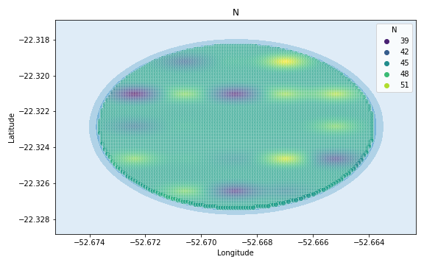
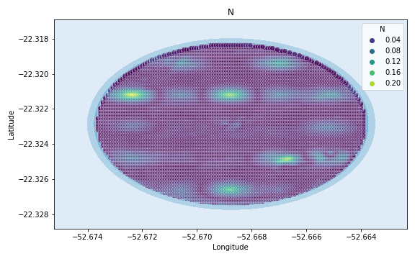
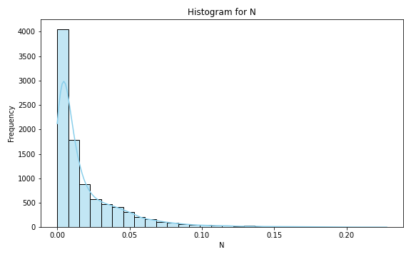
Analysis for column: N Model: Neural Network
Statistics:
mean 0.019906
std 0.025981
min 0.000002
25% 0.003726
50% 0.009669
75% 0.026488
80% 0.033322
85% 0.041040
90% 0.051638
95% 0.070882
99% 0.129695

Slide 2
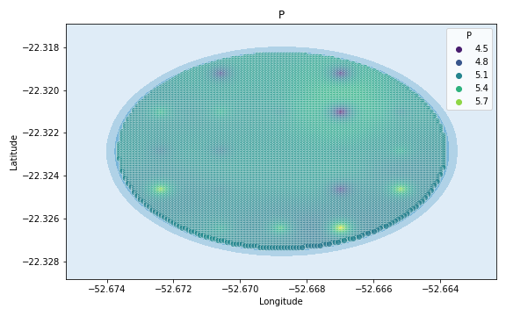
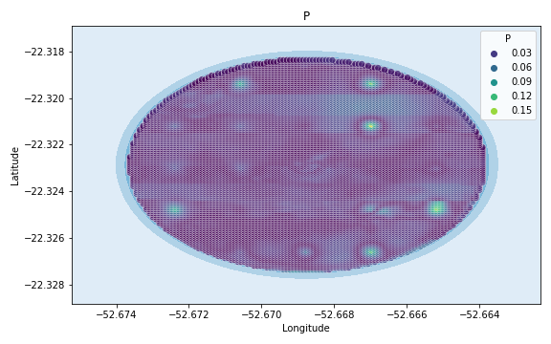
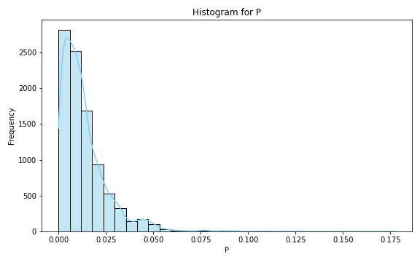
Analysis for column: P Model: Neural Network
Statistics:
mean 1.351907e-02
std 1.327652e-02
min 4.541539e-07
25% 4.822122e-03
50% 1.017688e-02
75% 1.776424e-02
80% 2.048635e-02
85% 2.369893e-02
90% 2.892640e-02
95% 3.882411e-02
99% 5.859519e-02

Slide 3
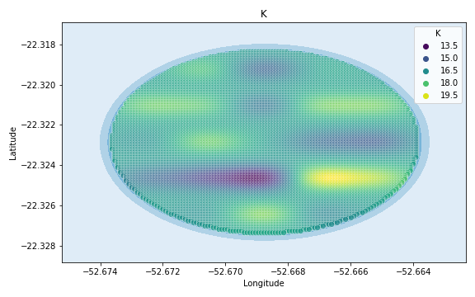
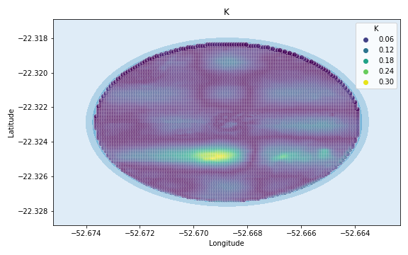
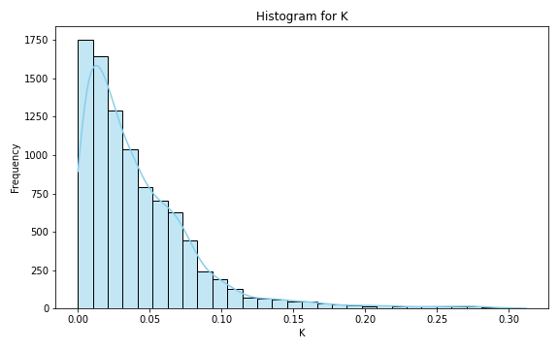
Analysis for column: K Model: Neural Network
Statistics:
mean 0.042587
std 0.041963
min 0.000006
25% 0.013847
50% 0.031124
75% 0.059175
80% 0.066616
85% 0.074877
90% 0.087570
95% 0.117434
99% 0.219198

Slide 4
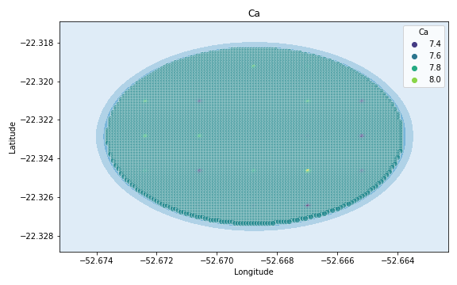
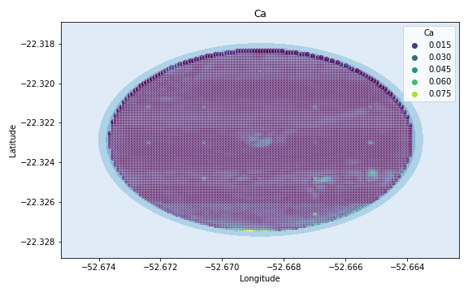
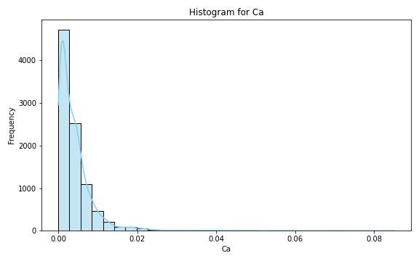
Analysis for column: Ca Model: Neural Network
Statistics:
mean 4.150280e-03
std 5.297415e-03
min 9.663502e-07
25% 1.075745e-03
50% 2.783635e-03
75% 5.320615e-03
80% 6.090433e-03
85% 7.182540e-03
90% 8.760454e-03
95% 1.197434e-02
99% 2.401298e-02

Slide 5
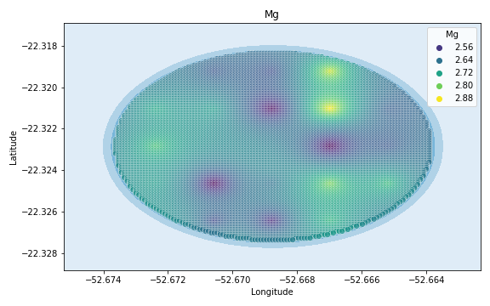
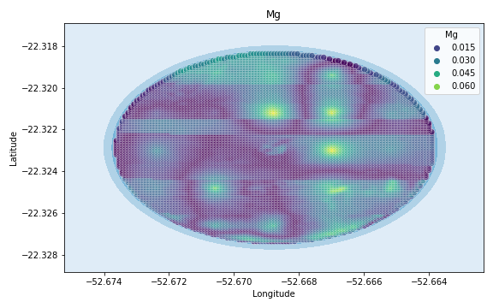
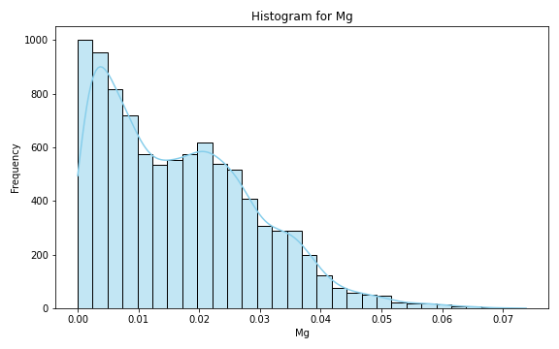
Analysis for column: Mg Model: Neural Network
Statistics:
mean 0.016854
std 0.012571
min 0.000001
25% 0.006025
50% 0.015089
75% 0.025119
80% 0.027464
85% 0.030523
90% 0.034531
95% 0.039203
99% 0.051677

Slide 6
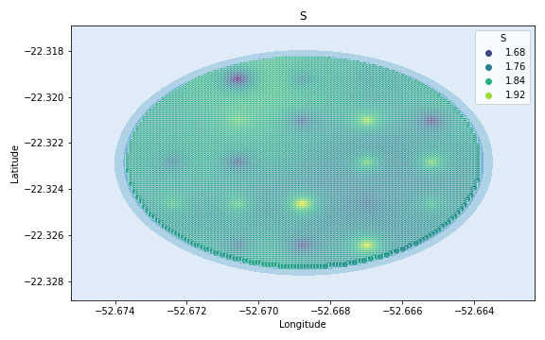
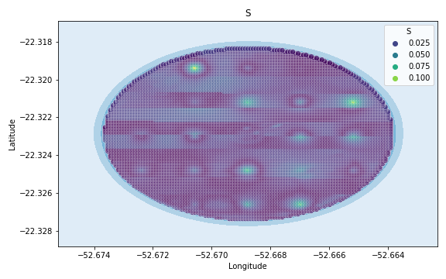
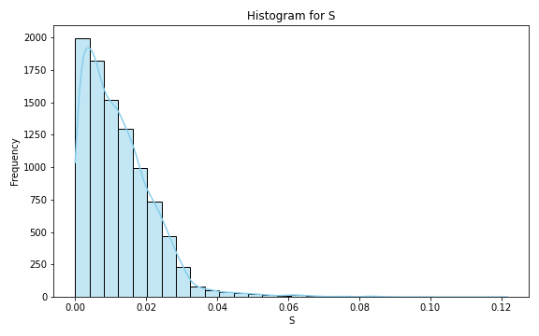
Analysis for column: S Model: Neural Network
Statistics:
mean 1.235443e-02
std 1.024268e-02
min 5.487692e-08
25% 4.744112e-03
50% 1.043820e-02
75% 1.749637e-02
80% 1.951281e-02
85% 2.189081e-02
90% 2.484551e-02
95% 2.900331e-02
99% 4.889712e-02

Slide 7
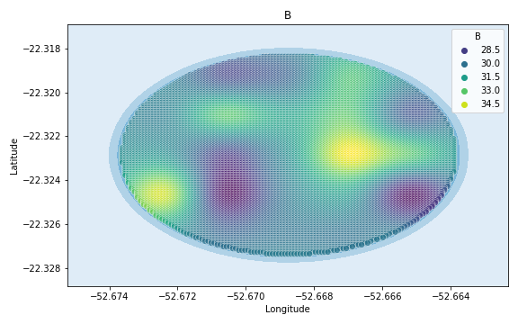
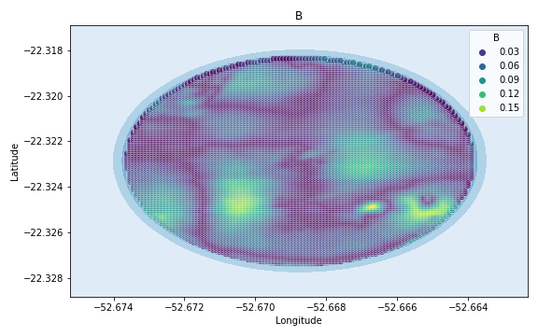
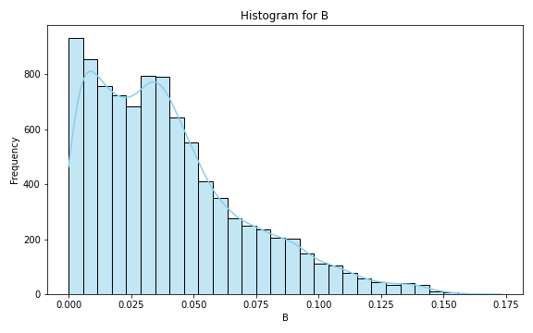
Analysis for column: B Model: Neural Network
Statistics:
mean 0.039867
std 0.030626
min 0.000009
25% 0.015645
50% 0.034109
75% 0.055406
80% 0.063190
85% 0.073137
90% 0.084879
95% 0.101297
99% 0.132631

Slide 8
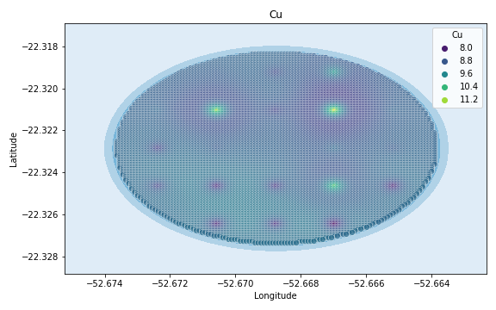
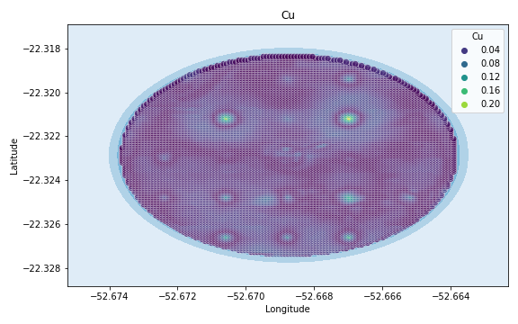
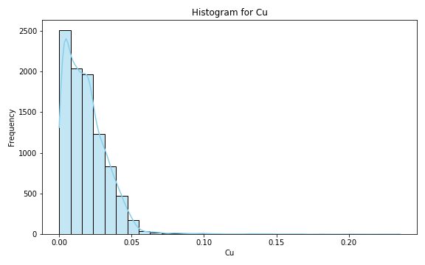
Analysis for column: Cu Model: Neural Network
Statistics:
mean 1.865520e-02
std 1.533238e-02
min 2.784772e-07
25% 7.237815e-03
50% 1.620507e-02
75% 2.655935e-02
80% 2.965423e-02
85% 3.304072e-02
90% 3.733155e-02
95% 4.355833e-02
99% 6.317648e-02

Slide 9
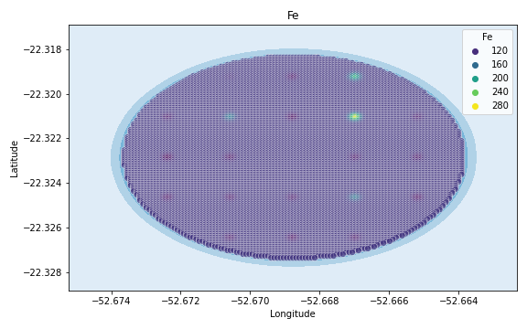
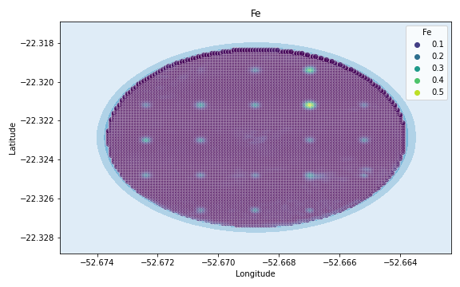
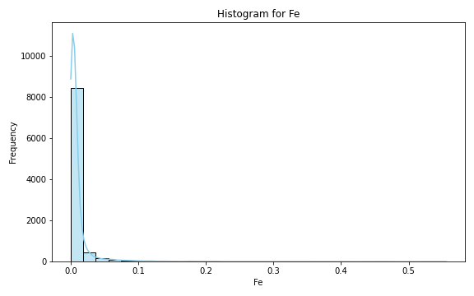
Analysis for column: Fe Model: Neural Network
Statistics:
mean 1.039133e-02
std 2.801423e-02
min 6.881738e-08
25% 2.004828e-03
50% 3.967640e-03
75% 7.524510e-03
80% 9.367962e-03
85% 1.229900e-02
90% 1.815974e-02
95% 3.767168e-02
99% 1.398395e-01

Slide 10
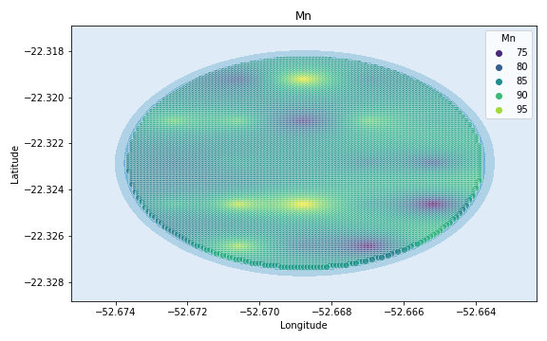
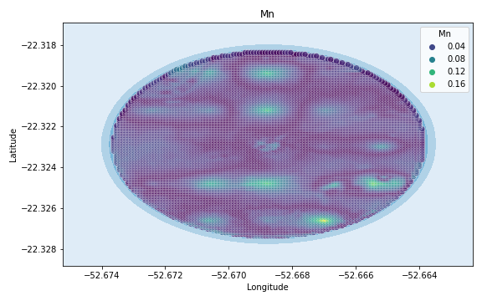
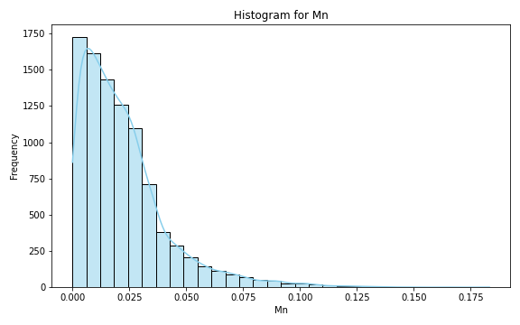
Analysis for column: Mn Model: Neural Network
Statistics:
mean 0.022308
std 0.019598
min 0.000003
25% 0.008267
50% 0.017810
75% 0.029623
80% 0.033304
85% 0.037776
90% 0.046304
95% 0.061388
99% 0.094388

Slide 11
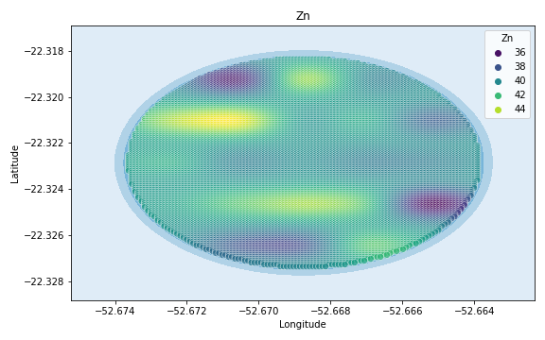
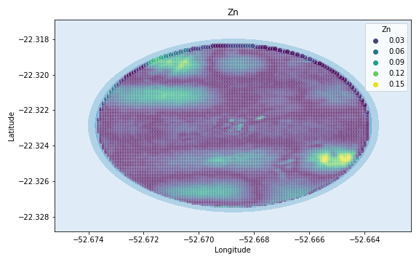
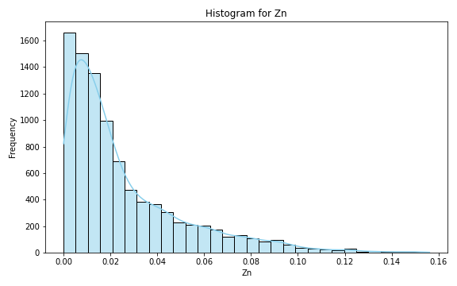
Analysis for column: Zn Model: Neural Network
Statistics:
mean 0.025646
std 0.025915
min 0.000003
25% 0.007388
50% 0.016374
75% 0.035565
80% 0.042473
85% 0.051578
90% 0.063457
95% 0.081745
99% 0.114857

Slide 12
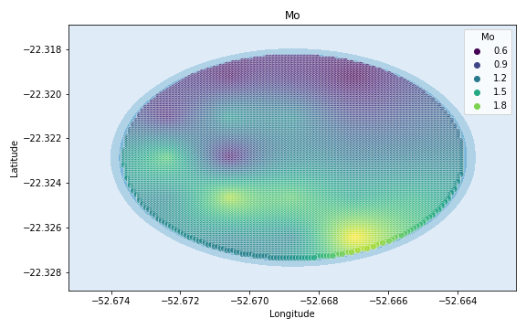
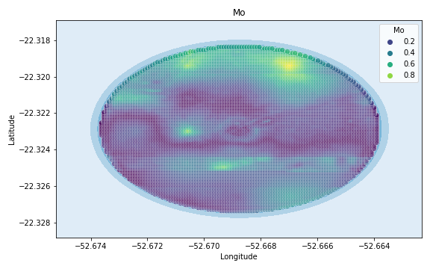
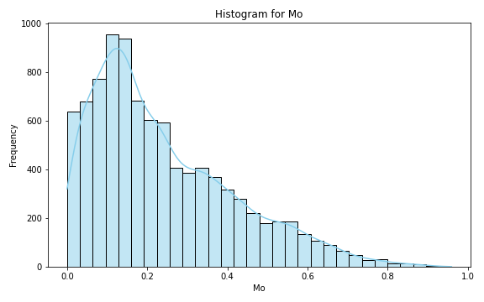
Analysis for column: Mo Model: Neural Network
Statistics:
mean 0.240114
std 0.178219
min 0.000050
25% 0.104902
50% 0.192822
75% 0.347711
80% 0.389463
85% 0.439251
90% 0.509221
95% 0.594037
99% 0.743780

Slide 13
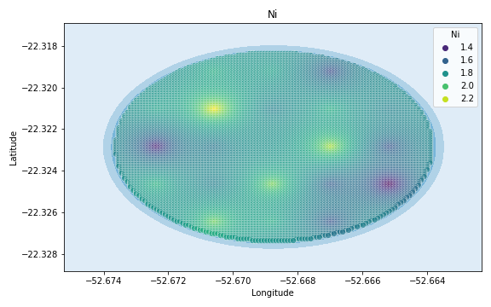
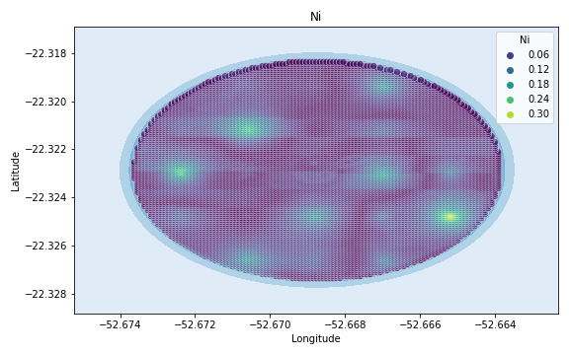
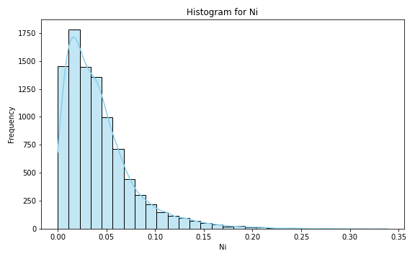
Analysis for column: Ni Model: Neural Network
Statistics:
mean 4.227936e-02
std 3.609130e-02
min 9.689779e-07
25% 1.676799e-02
50% 3.383434e-02
75% 5.613456e-02
80% 6.286328e-02
85% 7.208712e-02
90% 8.723759e-02
95% 1.136306e-01
99% 1.736077e-01

Slide 14
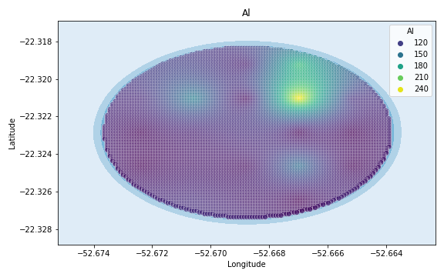
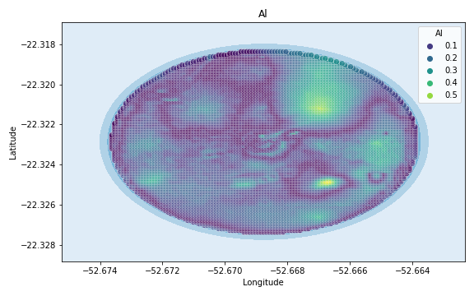
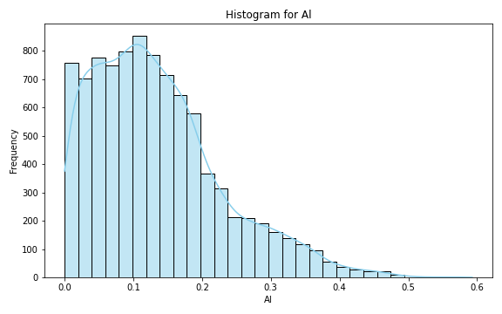
Analysis for column: Al Model: Neural Network
Statistics:
mean 0.135259
std 0.095233
min 0.000060
25% 0.062080
50% 0.119535
75% 0.184997
80% 0.204175
85% 0.231507
90% 0.271448
95% 0.325278
99% 0.413339

Slide 15
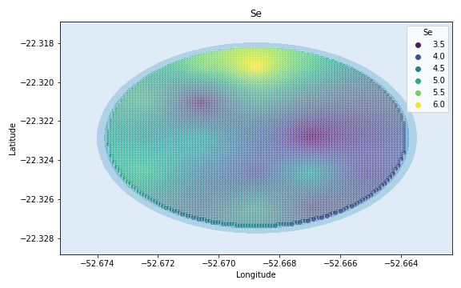
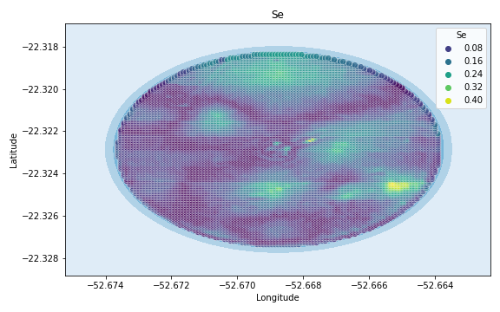
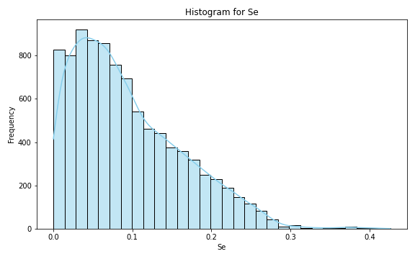
Analysis for column: Se Model: Neural Network
Statistics:
mean 0.094026
std 0.069164
min 0.000040
25% 0.039359
50% 0.078134
75% 0.137347
80% 0.153504
85% 0.172732
90% 0.195454
95% 0.227094
99% 0.273785

Slide 16
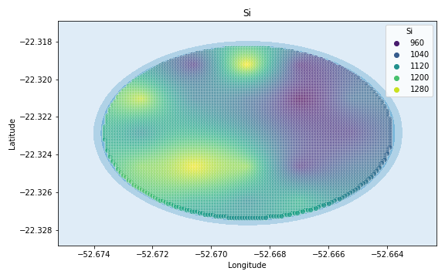
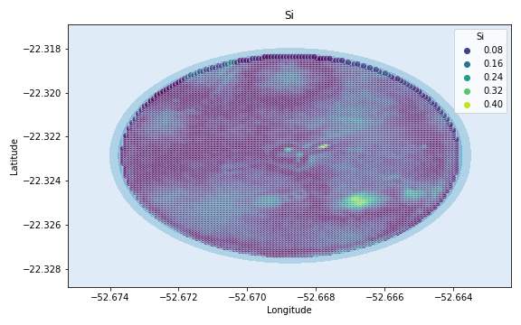
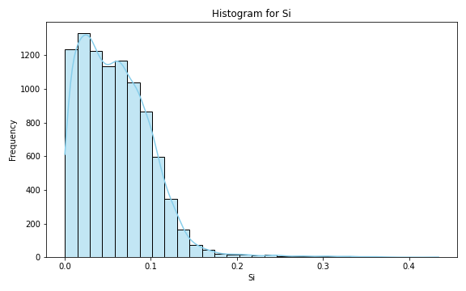
Analysis for column: Si Model: Neural Network
Statistics:
mean 0.059613
std 0.042632
min 0.000032
25% 0.026724
50% 0.054737
75% 0.084944
80% 0.092239
85% 0.100440
90% 0.110261
95% 0.127475
99% 0.195231

Slide 17
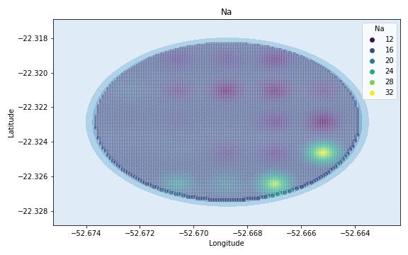
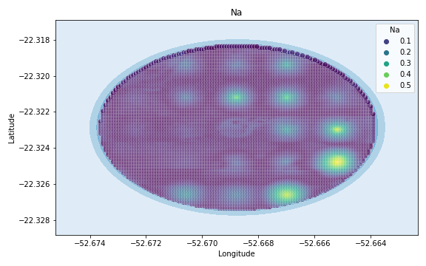

Analysis for column: Na Model: Neural Network
Statistics:
mean 5.442646e-02
std 7.064458e-02
min 2.399209e-07
25% 1.317458e-02
50% 2.916878e-02
75% 6.496267e-02
80% 7.925601e-02
85% 9.996588e-02
90% 1.318636e-01
95% 2.011732e-01
99% 3.655984e-01

Slide 18



Analysis for column: Va Model: Neural Network
Statistics:
mean 0.202236
std 0.187459
min 0.000011
25% 0.071473
50% 0.155030
75% 0.275173
80% 0.291880
85% 0.310932
90% 0.390231
95% 0.589624
99% 0.943970

Slide 19



Analysis for column: DRIS_N Model: Neural Network
Statistics:
mean 0.782798
std 14.993288
min 0.000001
25% 0.111051
50% 0.228650
75% 0.417981
80% 0.485293
85% 0.578944
90% 0.754683
95% 1.169908
99% 4.817355

Slide 20



Analysis for column: DRIS_P Model: Neural Network
Statistics:
mean 0.053852
std 0.058310
min 0.000003
25% 0.021164
50% 0.045183
75% 0.075579
80% 0.084669
85% 0.094461
90% 0.104549
95% 0.119184
99% 0.189348

Slide 21



Analysis for column: DRIS_K Model: Neural Network
Statistics:
mean 12.727132
std 572.099034
min 0.000103
25% 0.325869
50% 0.599397
75% 1.679342
80% 2.691385
85% 4.797854
90% 8.399662
95% 17.498775
99% 80.967496

Slide 22



Analysis for column: DRIS_Ca Model: Neural Network
Statistics:
mean 0.196573
std 0.192902
min 0.000055
25% 0.069230
50% 0.138849
75% 0.245974
80% 0.289340
85% 0.356469
90% 0.457627
95% 0.602673
99% 0.864315

Slide 23



Analysis for column: DRIS_Mg Model: Neural Network
Statistics:
mean 0.449674
std 2.853823
min 0.000038
25% 0.117685
50% 0.264225
75% 0.425539
80% 0.471246
85% 0.539262
90% 0.700225
95% 1.040224
99% 2.811225

Slide 24



Analysis for column: DRIS_S Model: Neural Network
Statistics:
mean 0.094348
std 0.755626
min 0.000016
25% 0.027881
50% 0.056429
75% 0.102814
80% 0.122536
85% 0.147965
90% 0.187749
95% 0.280780
99% 0.466709

Slide 25



Analysis for column: DRIS_B Model: Neural Network
Statistics:
mean 0.157284
std 0.233344
min 0.000001
25% 0.055844
50% 0.104836
75% 0.185434
80% 0.211741
85% 0.247794
90% 0.308936
95% 0.446589
99% 0.982617

Slide 26



Analysis for column: DRIS_Cu Model: Neural Network
Statistics:
mean 0.167280
std 0.284997
min 0.000053
25% 0.045150
50% 0.090574
75% 0.189054
80% 0.211968
85% 0.250120
90% 0.281037
95% 0.506025
99% 1.607113

Slide 27



Analysis for column: DRIS_Fe Model: Neural Network
Statistics:
mean 0.302318
std 1.359740
min 0.000064
25% 0.058428
50% 0.114757
75% 0.204917
80% 0.246272
85% 0.370418
90% 0.599505
95% 0.970612
99% 3.694346

Slide 28



Analysis for column: DRIS_Mn Model: Neural Network
Statistics:
mean 0.008884
std 0.062944
min 0.000120
25% 0.002624
50% 0.006458
75% 0.011642
80% 0.012213
85% 0.013028
90% 0.022534
95% 0.024668
99% 0.028332

Slide 29



Analysis for column: DRIS_Zn Model: Neural Network
Statistics:
mean 1.282724
std 12.166962
min 0.000007
25% 0.279215
50% 0.454308
75% 0.670012
80% 0.740777
85% 0.925551
90% 1.306896
95% 2.325477
99% 14.197604

Slide 30



Analysis for column: IMS Model: Neural Network
Statistics:
mean 3.628945e-02
std 2.970395e-01
min 6.370817e-07
25% 1.425966e-02
50% 2.607453e-02
75% 3.611114e-02
80% 4.214274e-02
85% 4.373096e-02
90% 6.274413e-02
95% 6.635086e-02
99% 9.773104e-02

Slide 31



Analysis for column: IBN Model: Neural Network
Statistics:
mean 6.260582e-02
std 1.454467e-01
min 4.481030e-07
25% 1.820655e-02
50% 3.697754e-02
75% 6.782666e-02
80% 7.675144e-02
85% 9.055359e-02
90% 1.126122e-01
95% 1.611418e-01
99% 4.828445e-01

